Slide 1
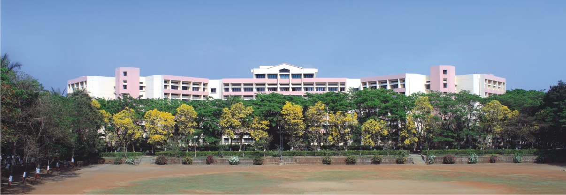

K.K.WAGH INSTITUTE OF ENGINEERING EDUCATION & RESEARCH Sign-to-Speech Conversion Using CNN
Group Id: 27
Internal Guide: Prof. N. M. Shahane
External Guide
Notes:
NOTE:
To change the image on this slide, select the picture and delete it. Then click the Pictures icon in the placeholder to insert your own image.

Slide 2
TEAM MEMBERS
Division./ Roll No. | ExaM Seat No. | Name of the student
B - 33 | B150134351 | Shubham Zope
B - 34 | B150134331 | Sanket Sonar
B - 35 | B150134350 | Abhijit Watpade
B - 36 | B150134319 | Sameer Rathod

Slide 3

Content
Problem Definition
Objectives
Motivation of the Project
Requirement Specification
Literature Survey
Block diagram of Project/Architecture
Methodology
Algorithms
References

Slide 4
PROBLEM DEFINITION
To create a computer software and train a model using CNN which takes an image of hand gesture of American Sign Language and shows the output of the particular sign language in text format converts it into audio format.

Slide 5
OBJECTIVES
To create a completely functional product for the people who are not able to hear, so that ,they can get connected to world easily .
To use and understand technologies like OpenCV, Matplotlib,Keras,Deep Learning,Python , Heroku host etc.
To create a Web based project for detecting and understanding American sign language using Machine Learning concepts.

Slide 6
MOTIVATION OF THE PROJECT
Interaction Barrier for D&M Peoples.
If there is a common interface that converts the sign language to text the hand gestures can be easily understood by the other people.
Develop User Friendly Human Computer Interface.

Slide 7
REQUIREMENT SPECIFICATION
Software
Python 3.6.6
Tensorflow 1.11.0
OpenCV 3.4.3.18
NumPy 1.15.3
Matplotlib 3.0.0
Keras 2.2.1

Slide 8
LITERATURE SURVEY
Data Acquisition :
Use of sensory devices(Gloves)
Vision based approach(Computer Camera)
Data Pre-processing and Feature Extraction :
Gaussian blur filter, Threshold filter, Gray filter
Colour segmentation

Slide 9
Gesture Classification :
Hidden Markov Model(HMM)
It deals with dynamic aspects of gesture. Gestures extracted from video images by tracking skin-color blobs
Naive Bayes classification(naive)
It deals with static aspects of gesture. Performs well with small datasets
Convolution Neural Network(CNN)
It construct a skin model to extract the hand out of an image and then apply binary threshold to the whole image

Slide 10
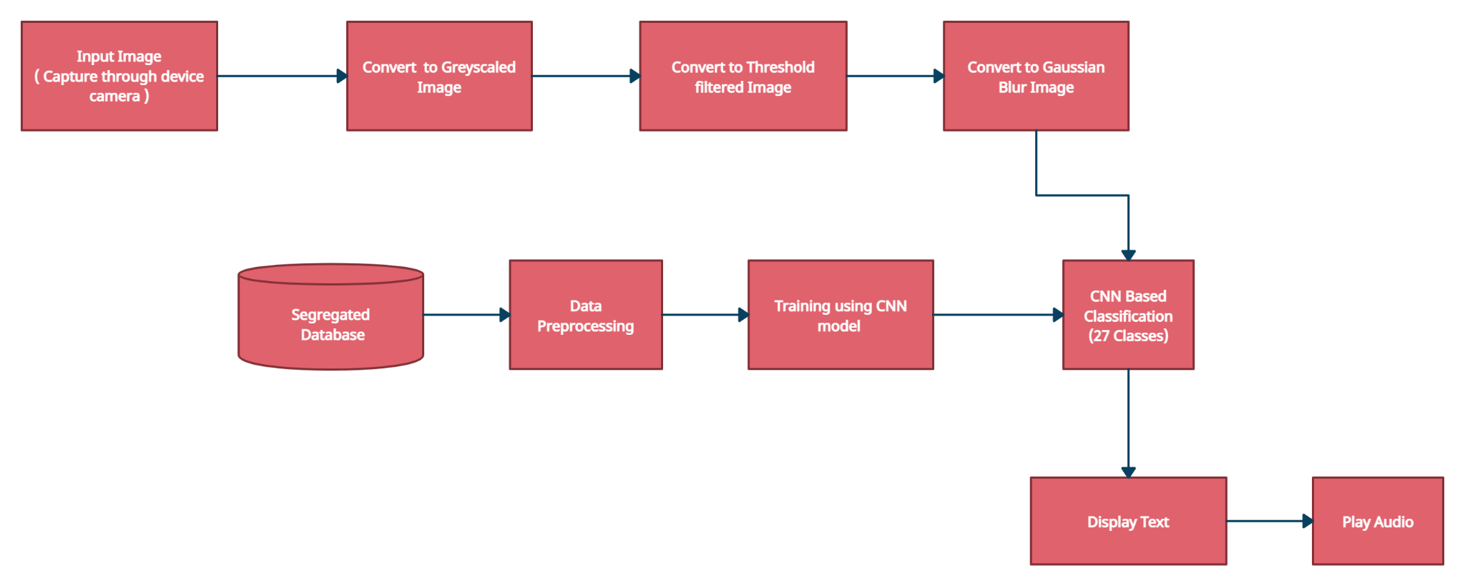
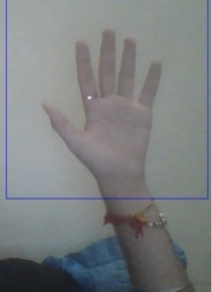
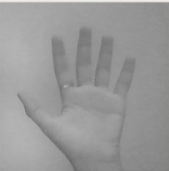
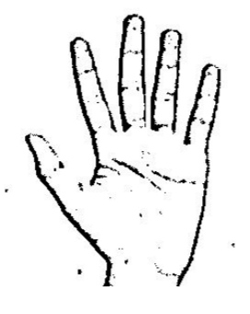

BLOCK DIAGRAM

Slide 11
METHODOLOGY
The project can be made using vision based approach. All the signs are represented with bare hands and so it eliminates the problem of using any artificial devices for interaction.
DATA SET :- We didn't found any database which is in a format which will help us to train our model quickly, so , we have decided to create our own database which will contain the black and white formated images , using OpenCv filters , rather than using the RGB dataset.
GESTURE CLASSIFICATION :-
Apply gaussian blur filter and threshold to the frame taken with opencv to get the processed image after feature extraction.
This processed image is passed to the CNN model for prediction and if a letter is detected then the letter is printed and taken into consideration for forming the word.
Space between the words are considered using the blank screen.

Slide 12
ALGORITHMS
CNN (Convolutional Neural Network) :- It is most preferably used algorithm for operations upon the images. In simple word what CNN does is, it extract the feature of image and convert it into lower dimension without losing its characteristics .So that working upon it would not take more computational power.
Layers :-
Convolutional Layers
Poling Layers
Max Pooling
Fully Connected Layer
Final Output Layer

Slide 13
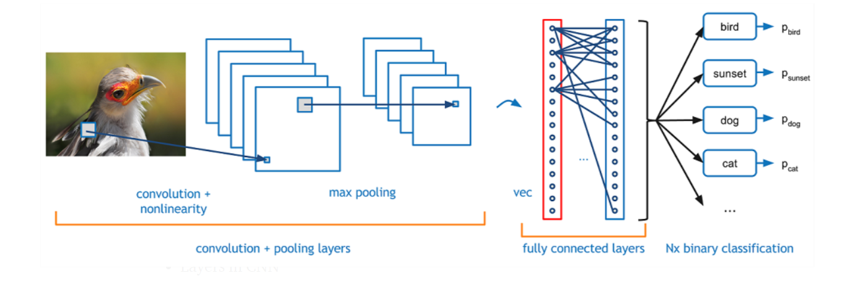
Activation Function :- We have decided to use ReLU(Rectified Linear Unit) as our activation function in each layer. It is a simple function stated as f(x) = max(0,x) for each input pixel .The biggest advantage is it adds the nonlinearity to the model and removes vanishing gradient problem for value greater than 0 .
Optimizer :- As our optimizer function we have decided to use Adam optimizer for updating the model in response to the output of the loss function. It is mostly used Gradient Descent optimizer because it use advantages of both stochastic gradient descent algorithms namely adaptive gradient algorithm(ADA GRAD) and root mean square propagation(RMSProp)

Slide 14
REFERENCES
Real-Time Hand Gesture Recognition Using Finger Segmentation Zhi-hua Chen, Jung-Tae Kim, Jianning Liang, Jing Zhang, and Yu-Bo Yuan
Hidden Markov model-based Sign Language to Speech Conversion System Aiswarya V, Naren Raju N, Johanan Joy Singh S, Nagarajan T, Vijayalakshmi P
Sign Language Recognition System Based on Weighted Hidden Markov Model Wenwen Yang, Jinxu Tao, Changfeng Xi, Zhongfu Ye
Dynamic Hand Gesture Recognition Using Kinect Sensor Devendra kumar H. Pal, S. M. Kakade
Hand Gesture Recognition Akash Verma , Gourav Soni , Pankaj Kumar Sangam , Gitanjali Ganpatrao Nikam , Mukta Rani Dhiman

Slide 15
THANK YOU !!

